Slide 1

CMR COLLEGE OF ENGINEERING & TECHNOLOGY
Kandlakoya, Medchal, Hyderabad - 501401
Department of Computer Science and Engineering
DUAL-PURPOSE HYPER-HEURISTIC SUPPORT VECTOR
MACHINE DESIGNED FOR ADDRESSING CYBER SECURITY ISSUES IN BIG DATA ENVIRONMENTS
Name of the student:
20H51A05K4-Ch.Sridham
20H51A0512-G.Poojitha
20H51A05Q1-Imtiyaz Ahmad Wani
Under esteemed guidance of
Ms.G.Srividya
(Assistant Professor)

Slide 2
Outline
Abstract
Introduction
Literature survey
Existing system
- Problems in existing system
Research Objective of Presentation
Problem Definition
Research work
- Proposed system architecture
- Methods
- Comparison of Proposed system with an existing system
Performance Measure
Results
Conclusion
Future Work
References
Notes:
2

Slide 3
Abstract
Notes:
3

Slide 4
ABSTRACT
Cyber security in the context of big data is known to be a critical problem and presents a great challenge to the research community. Machine learning algorithms have been suggested as candidates for handling big data security problems. Among these algorithms, support vector machines (SVMs) have achieved remarkable success on various classification problems.
However, to establish an effective SVM, the user needs to define the proper SVM configuration in advance, which is a challenging task that requires expert knowledge and a large amount of manual effort for trial and error.
In this project, we formulate the SVM configuration process as a bi-objective optimization problem in which accuracy and model complexity are considered as two conflicting objectives. We propose a hyper-heuristic framework which is dual-objective that is independent of the problem domain.

Slide 5
INTRODUCTION
Notes:
5

Slide 6
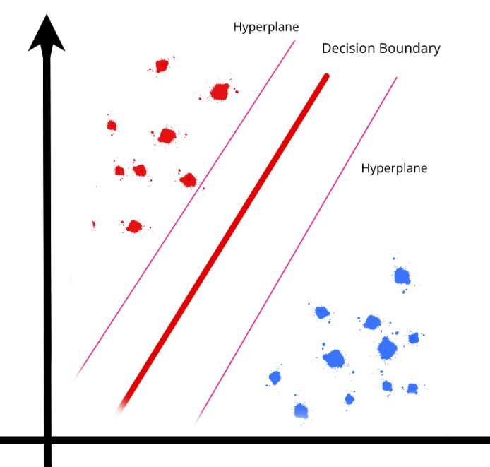
Introduction
Most of existing malware detection methods are mainly proposed to deal with small-scale datasets and unable to handle big data within a moderate amount of time. In addition, these methods are very costly to maintain and they have very low success rates. To address the above issues, machine learning (ML) algorithms such as SVM have been proposed for classifying unknown patterns.
This work presents a dual purposed hyper-heuristic framework that mimics SVM working and also tackles drawbacks of SVM.
Our proposed hyper-heuristic framework (Independent of problem at hand) encompasses several key elements that separate it from existing to find an effective way to implement SVM working without the need to set several configurations.
Notes:
6

Slide 7
Literature Survey
Notes:
7

Slide 8
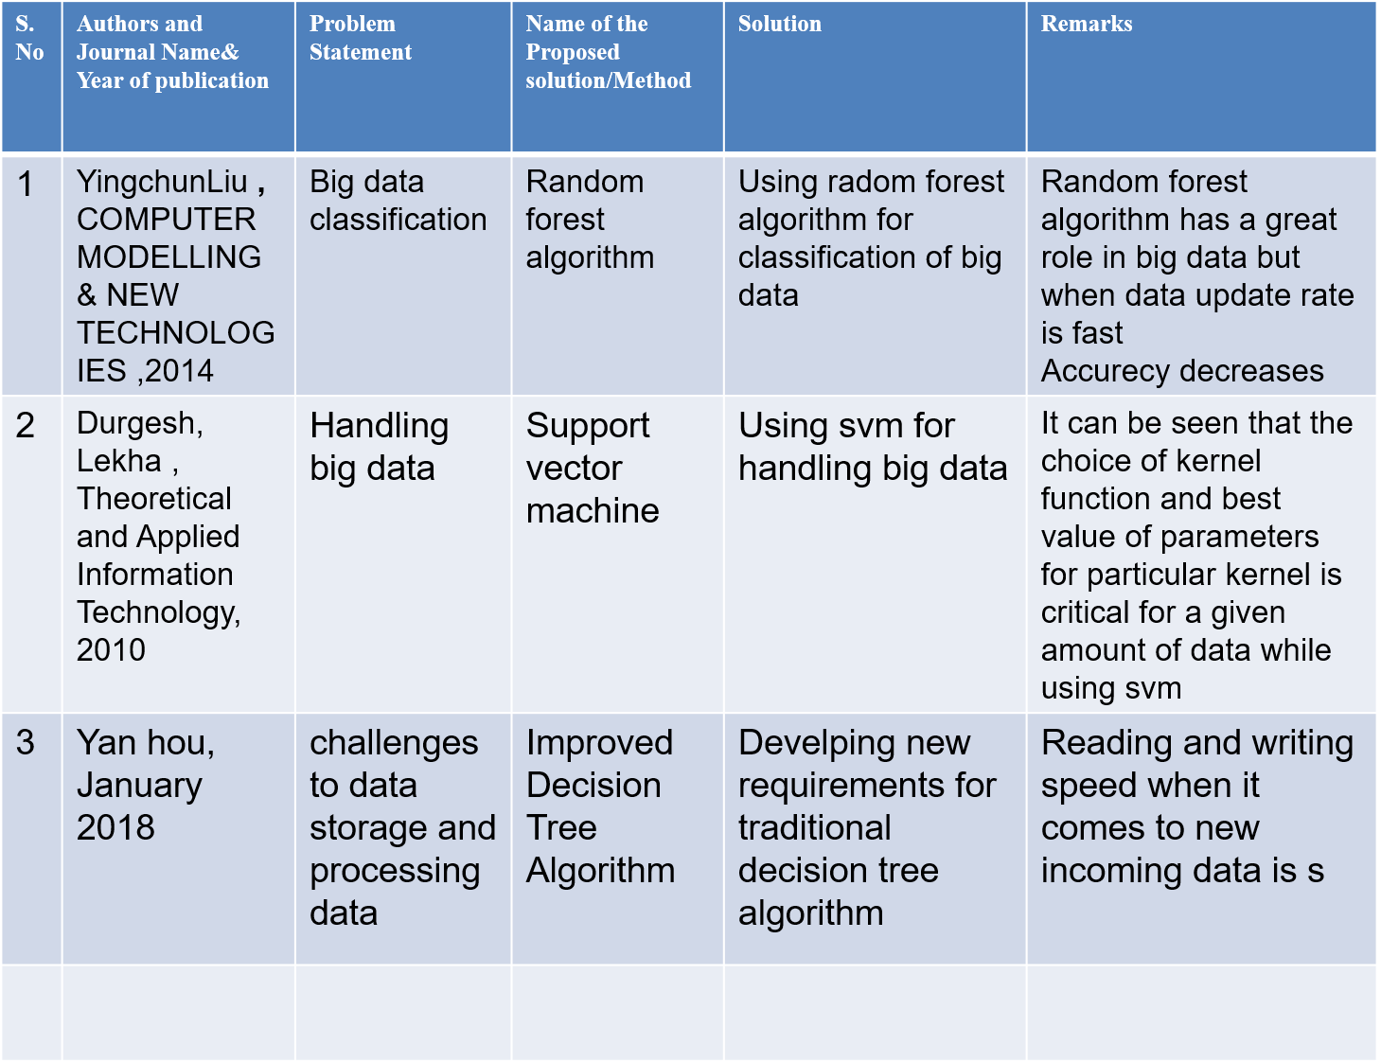
Existing system
table for the existing system
Notes:
8

Slide 9
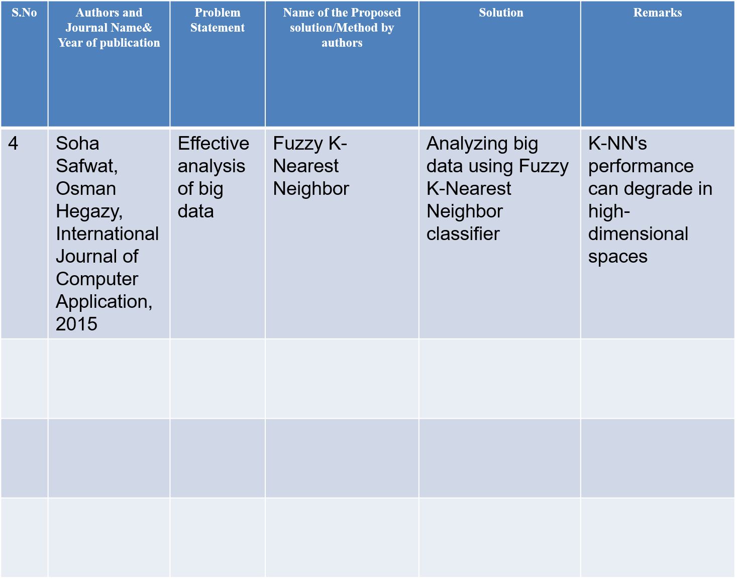

Slide 10
Research Objective
Notes:
10

Slide 11
Research objective
The primary objective of this project is to develop a novel purposed Hyper-heuristic approach for Support Vector Machines (SVM) in the domain of big data cyber-security. The project aims to address the challenges associated with handling large-scale datasets efficiently while optimizing the detection rate of cyber threats and minimizing false positives simultaneously.
One objective is to investigate and design an algorithm that can automatically segregate data into groups without the requirement of setting up configurations as of in SVM. By leveraging hyper-heuristics, the algorithm will intelligently search through a vast space of potential solutions This objective will contribute to enhancing speed and accuracy of the classification
Another objective is to develop an approach that can handle the computational demands of big data analytics efficiently.

Slide 12
Problem Definition
Notes:
12

Slide 13
Problem Definition
Support Vector Machines (SVM) have emerged as a popular technique for addressing cyber-security challenges. However, the traditional SVM approach often struggles to handle large-scale datasets efficiently, leading to reduced accuracy and increased computational time. Moreover, cyber-security professionals face the challenge of balancing two conflicting objectives: maximizing the detection rate of cyber threats and minimizing false positives.
To address these issues, this project aims to develop a dual purposed Hyper-heuristic approach for Support Vector Machines in the context of big data cyber-security. The project seeks to investigate and design an algorithm that can automatically classify the data without any manual setting of configurations as of SVM. It gives speedy as well as accurate result hence dual-purposed.

Slide 14
Research Work
Notes:
14

Slide 15
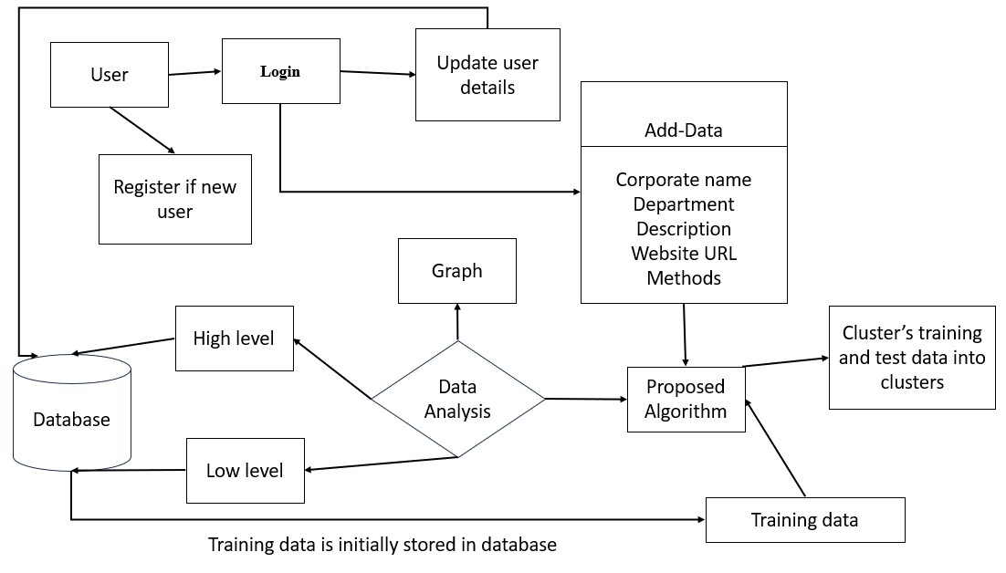
Proposed system architecture

Slide 16
Proposed Methods
our website would allow users to enter details such as "what kind of problem the user's website is undergoing (such as got hacked, lost or stolen data from the website, etc), description, company name, website URL etc. Based on user input our algorithm will classify the issues into various groups and inform what kind of virus users' websites might be subjected to (such as polymorphic virus or macro virus etc).
Here we are doing the same work as SVM which would be the classification of data but without need of manual setting of configurations.
our algorithm groups training data into various groups each titled with a unique virus name.
whenever a user inputs his website issues, based on input the algorithm will decide which group the input issues (given by the user) belong to, hence providing the user the type of virus the user's website must have undergone this depicts indirect usage of hyper heurastics.

Slide 17
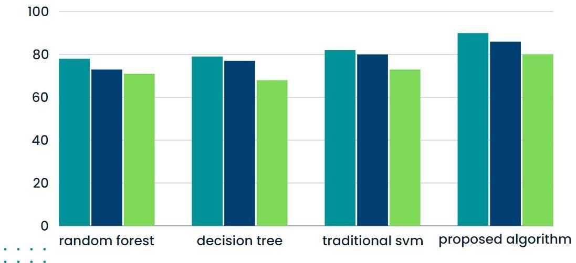
Performance Measure:
Y- axis : percentages
X-axis : algorithms
Recall
Precision
Accuracy

Slide 18
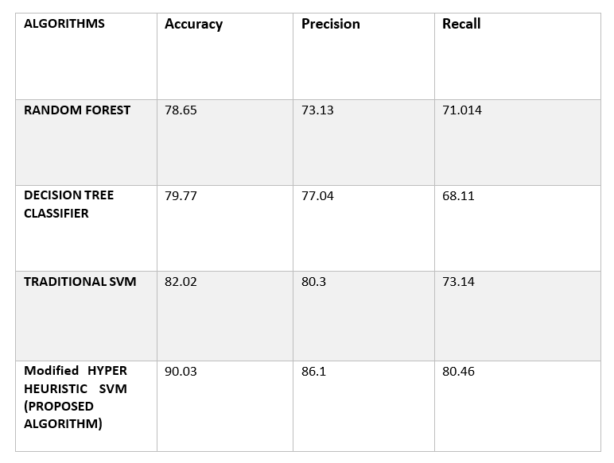
Value comparison of various algorithms:

Slide 19


Result Analysis
. Registration Page
.Login page

Slide 20
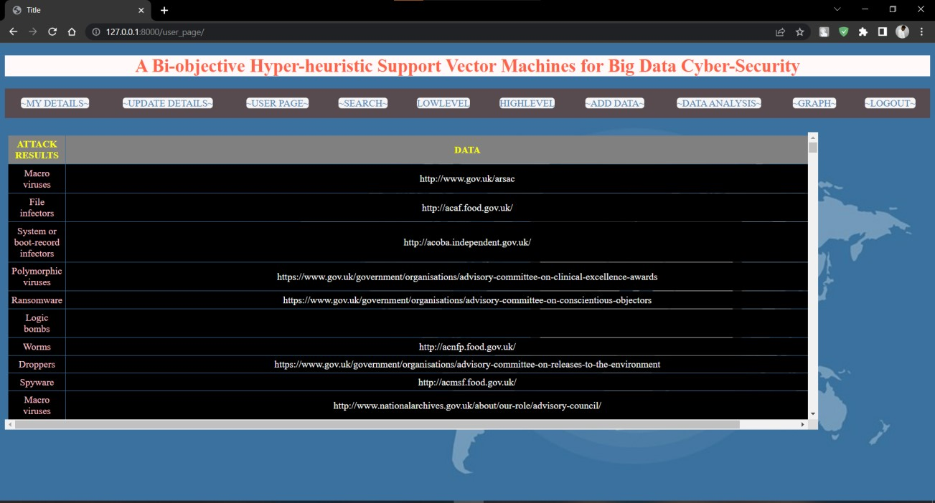
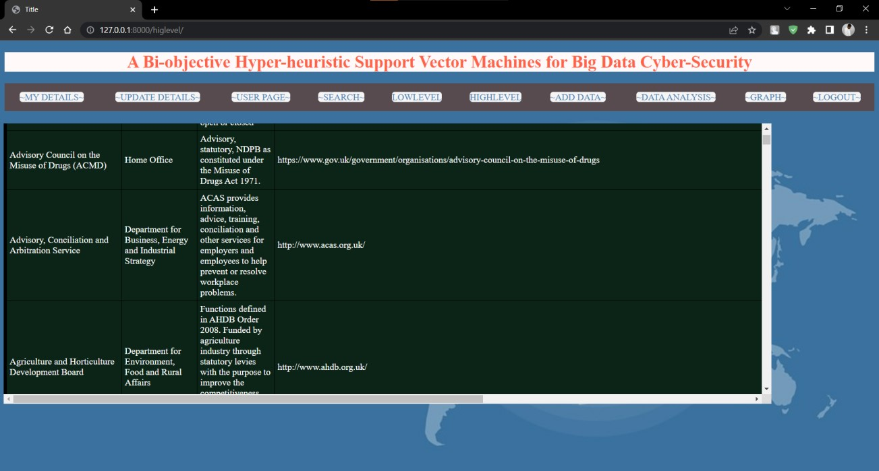
.User page
.High Level

Slide 21

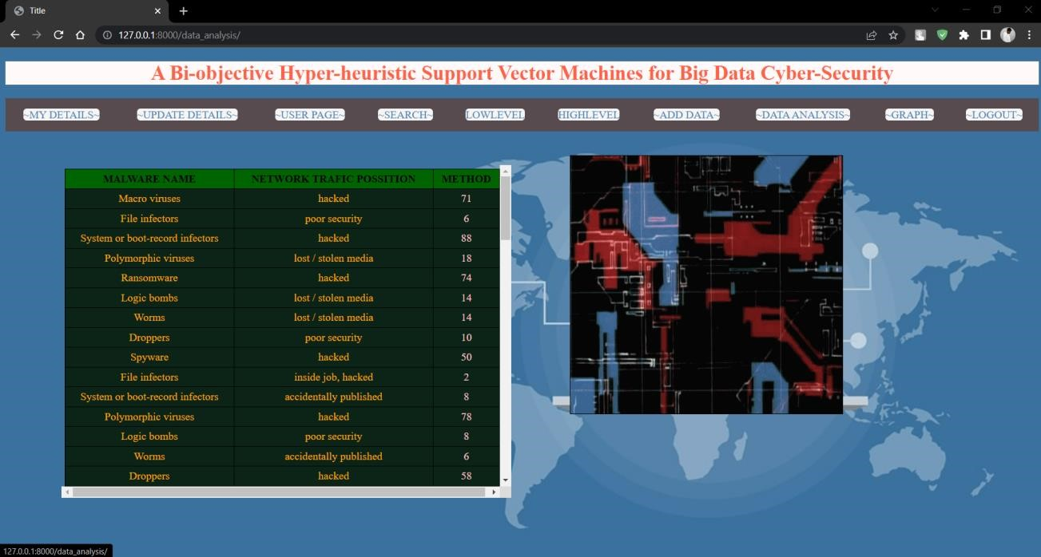
. Add Data
Data Analysis

Slide 22
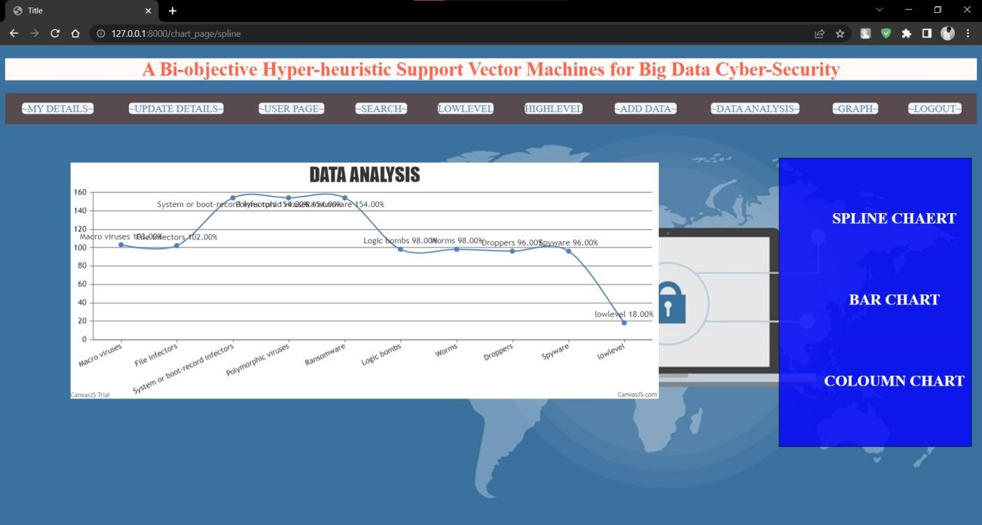
Graph:

Slide 23
Conclusion
This project, a hyper-heuristic SVM optimization model is suggested to face with cybersecurity issues. We remodeled the SVM setup process as a dual- goal optimization issue, where precision and model intricacy are seen as opposing priorities. This dual-goal optimization issue can be dealt through the hyper-heuristic system.

Slide 24
Future work
Our project caters the drawbacks of svm but there is always the scope of increasing the accuracy of classification (done by our algorithm) by training the model with more as well as harder datasets .hyper heuristics are used in this project hence our work gives a speedy and accurate result. Our algorithm can also be further tuned to handle much larger dataset.

Slide 25
References
[1] Yingchun Liu, proposed an optimized upgradation of Random forest algorithm in big data environment, COMPUTER MODELLING & NEW TECHNOLOGIES 2014.
[2] DURGESH K, SRIVASTAVA, LEKHA BHAMBHU, discussed on “DATA CLASSIFICATION USING SVM", Journal of Theoretical and Applied Information Technology,2010.
[3] Yan Hou, proposed optimized approach of Decision Tree Algorithm for Big Data Analysis,Advances in Intelligent Systems Research,International Conference on Transportation & Logistics, Information & Communication,2018.
[4] Malak El Bakry,Soha Safwat,Osman Hegazy, researched and published paper on "Big Data Classification using Fuzzy KNN",2015.
[5] Edmund K Burke, Michel Gendreau, Matthew Hyde, Graham Kendall, Gabriela Ochoa, Ender Özcan & Rong Qu provided an analysis on topic
“Hyper-heuristics: a survey of the state of the art”, Journal of the Operational Research Society ,(2013)
[6] Ximing Wang & Panos M. Pardalos,performed a Survey of Support Vector Machines with Uncertainties, Annals of Data Science,2015

Slide 26
Thank You!

